Slide 1
CS 355/555
Probability and Statistics for CS
Baocheng Geng
Lecture 18 03/05
CS 355/555 Probability and Statistics for CS

Slide 2






Introduction
Continuous Random Variables
1
Introduction
Continuous Random Variables Examples
Uniform Random Variable Examples
4
Expectation and Variance of Continuous Random Variables
5 Expectation and Variance of Continuous Random Variables
6
Exponential Random Variable
CS 355/555 Probability and Statistics for CS

Slide 3
Copyright Statement
Copyright Statement
Materials prepared for and/or included in this course are protected by copyright law. They are intended to be used only by students enrolled in this course during the current term and should not be further disseminated without prior permission from the course instructor.
CS 355/555 Probability and Statistics for CS

Slide 4
Example - Continuous Random Variable
Speed of a car
0, . . . , 80
Temperature
98, 98.6, 98.58 . . .
CS 355/555 Probability and Statistics for CS

Slide 5
Continuous Random Variable
X is a continuous random variable if X takes values on R and the domain of X has an uncountable number of values.
CS 355/555 Probability and Statistics for CS

Slide 6

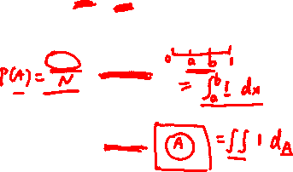
Continuous Random Variable
Mostly, the ideas are the same for continuous Random Variables as for discrete. However:
Sums
Probability
#(A) ⇒ length(A)
A one variable
Probability
#(A) ⇒ area(A)
A two variables
CS 355/555 Probability and Statistics for CS
5/42 13:34

Slide 7
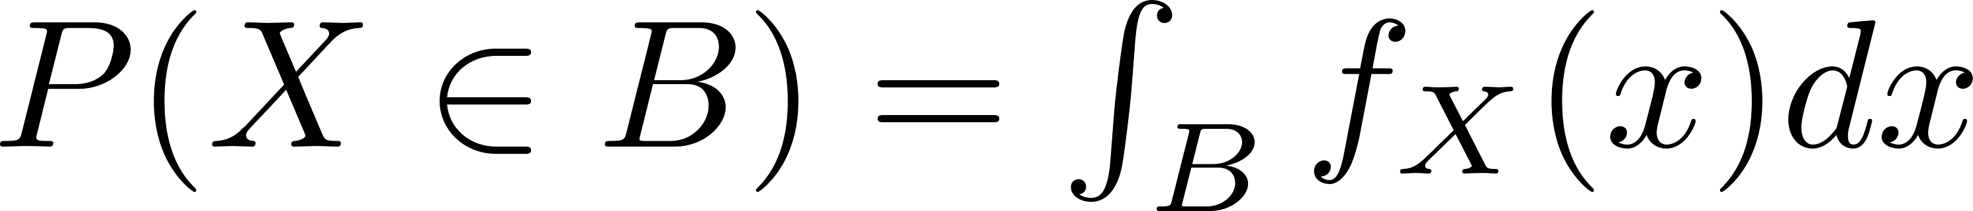
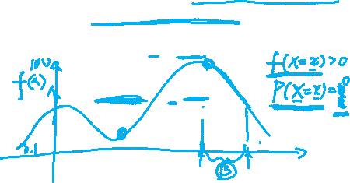
Probability Density Function
A continuous Random Variable X has a Probability Density Function
Probability Density Function - a nonnegative function
f_{X} : Ω → [0, ∞]
Probability Density Function
CS 355/555 Probability and Statistics for CS
7/42 13:34

Slide 8
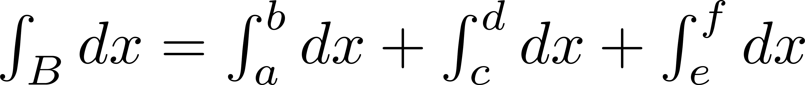
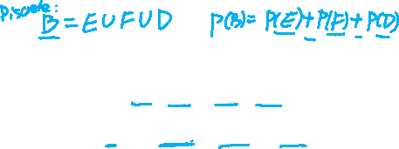
Continuous Random Variable
Some notation
B = (a, b) ∪ (c, d) ∪ (e, f )
CS 355/555 Probability and Statistics for CS

Slide 9

Probability Density Functions Attributes
Usually P (X = x) = 0 for most values
CS 355/555 Probability and Statistics for CS
9/42 13:34

Slide 10
Probability Density Functions Attributes
Usually P (X = x) = 0 for most values
f_{X} (x) ≥ 0
CS 355/555 Probability and Statistics for CS
9/42 13:34

Slide 11

Probability Density Functions Attributes
Usually P (X = x) = 0 for most values
f_{X} (x) ≥ 0
P (X ∈ Ω) = f_{X} (x)dx = 1
Ω
CS 355/555 Probability and Statistics for CS
9/42 13:34

Slide 12

Probability Density Functions Attributes
Usually P (X = x) = 0 for most values
f_{X} (x) ≥ 0
P (X ∈ Ω) = f_{X} (x)dx = 1
Ω
P (X ∈ B) = f_{x}(x) dx
B
b
P (X ∈ [a, b]) = f_{X} (x) dx
a
CS 355/555 Probability and Statistics for CS
9/42 13:34

Slide 13
Probability Density Functions Attributes
Usually P (X = x) = 0 for most values
f_{X} (x) ≥ 0
P (X ∈ Ω) = f_{X} (x)dx = 1
Ω
P (X ∈ B) = f_{x}(x) dx
B
b
P (X ∈ [a, b]) = f_{X} (x) dx
a
For Ω two dimensional, P (Z ∈ A) =
f_{Z} (x, y) dx dy
(x,y)∈A
CS 355/555 Probability and Statistics for CS
9/42 13:34

Slide 14
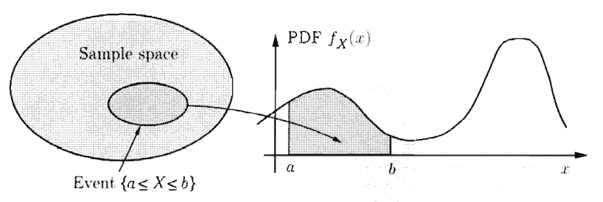
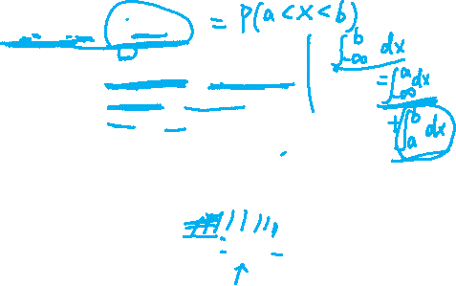
Probability Density Function
b
P (a ≤ X ≤ b) = f_{X} (x) dx
Picture
a
b
a
= f_{X} (x) dx −
f_{X} (x) dx
−∞ −∞
= P (X < b) − P (X < a)
= F_{X} (b) − F_{X} (a)
CS 355/555 Probability and Statistics for CS
11/42 13:34

Slide 15

Uniform Random Variable
X is a Uniform Random Variable on [a, b] if for Probability Density Function f_{X}
c if x ∈ [a, b]
f (x) =
X
0 otherwise
What is the value of c?
CS 355/555 Probability and Statistics for CS
14/42 13:34

Slide 16
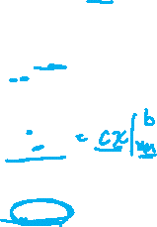
Uniform Random Variable
X is a Uniform Random Variable on [a, b] if for Probability Density Function f_{X}
c if x ∈ [a, b]
f (x) =
X
0 otherwise
What is the value of c?
1 = f_{X} (x) dx
R
∞
= c dx
−∞
b
= c dx
a
b
= c dx
a
= (b − a)c
CS 355/555 Probability and Statistics for CS
14/42 13:34

Slide 17
Uniform Random Variable
What is the value of c?
1
c =
b − a
CS 355/555 Probability and Statistics for CS

Slide 18

Uniform Random Variable
X is a Uniform Random Variable on [a, b]
1
f_{X} (x) = _{b − a}
x+δ
P (x < X < x + δ) =
f_{X} (x) dx
x
x+δ
= c dx
x
1
= × (x + δ − x) b − a
δ
=
b − a
CS 355/555 Probability and Statistics for CS
16/42 13:34

Slide 19
Uniform Random Variable
X is a Uniform Random Variable on [a, b]
f_{X} (x) = c = ¹ on [a, b]
b−a
F (d) = P (X ≤ d) =
d
f_{X} (x) dx
X
−∞
1
c
a
b
CS 355/555 Probability and Statistics for CS

Slide 20

A More Complicated Example 3.2, pg 142
Alvin’s driving time to work is between 15 and 20 minutes if the day is sunny, and between 20 and 25 minutes if the day is rainy, with all times being equally likely in each case.
2 1
A day is sunny with probability and rainy with probability .
3 3
What is the Probability Density Function of the driving time, viewed as a random variable X?
Warning
CS 355/555 Probability and Statistics for CS
19/42 13:34

Slide 21
A More Complicated Example 3.2, pg 142
Alvin’s driving time to work is between 15 and 20 minutes if the day is sunny, and between 20 and 25 minutes if the day is rainy, with all times being equally likely in each case.
CS 355/555 Probability and Statistics for CS
20/42 13:34

Slide 22
A More Complicated Example 3.2, pg 142
Alvin’s driving time to work is between 15 and 20 minutes if the day is sunny, and between 20 and 25 minutes if the day is rainy, with all times being equally likely in each case.
X is between 15 and 20 minutes if the day is sunny, and between 20 and 25 minutes if the day is rainy, with all times being equally likely in each case.
2 1
The day is sunny with probability and rainy with probability .
3
3
What is the PDF of X?
CS 355/555 Probability and Statistics for CS
20/42 13:34

Slide 23
A More Complicated Example 3.2, pg 142
2
X is between 15 and 20 minutes with probability , and between 20
3
1
and 25 minutes with probability with all times being equally
3
likely in each case. What is the PDF of X?
CS 355/555 Probability and Statistics for CS

Slide 24
A More Complicated Example 3.2, pg 142
2
X is between 15 and 20 minutes uniformly with probability , and
3
1
between 20 and 25 minutes uniformly with probability .
3
What is the PDF of X?
c₂
c₁
15
20
25
CS 355/555 Probability and Statistics for CS

Slide 25
A More Complicated Example 3.2, pg 142
2
X is between 15 and 20 minutes uniformly with probability , and
3
1
between 20 and 25 minutes uniformly with probability .
3
c 1
if 15 ≤ x ≤ 20}
f (x) = c if 20 ≤ x ≤ 25}
X 2
0 otherwise
CS 355/555 Probability and Statistics for CS

Slide 26
A More Complicated Example 3.2, pg 142
c 1
if 15 ≤ x ≤ 20
f (x) = c
2
if 20 ≤ x ≤ 25
X
0 otherwise
2
20
20
P (sunny) = = f_{X} (x) dx = c₁ dx = 5c₁ 3
15 15
2
c₁ = ₁₅
1
25
25
P (rainy) = = f_{X} (x) dx = c₂ dx = 5c₂ 3
20 20
1
c₂ = ₁₅
CS 355/555 Probability and Statistics for CS
24/42 13:34

Slide 27
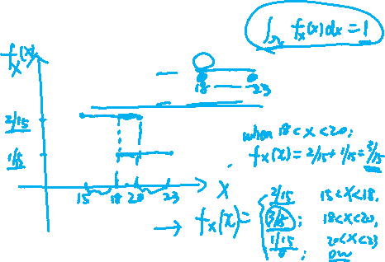
A More Complicated Example 3.2, pg 142
2
if 15 ≤ x ≤ 20
15
f_{X} (x) =
1
if 20 ≤ x ≤ 25
15
0 otherwise
CS 355/555 Probability and Statistics for CS
25/42 13:34

Slide 28
Uniform Random Variable
(Example 3.3)
f_{X} (x) can take large values
CS 355/555 Probability and Statistics for CS
26/42 13:34

Slide 29
Uniform Random Variable
f_{X} (x) can take large values
If a = 0, b = .001 then c = ¹ = 1000
.001−0
CS 355/555 Probability and Statistics for CS
26/42 13:34

Slide 30
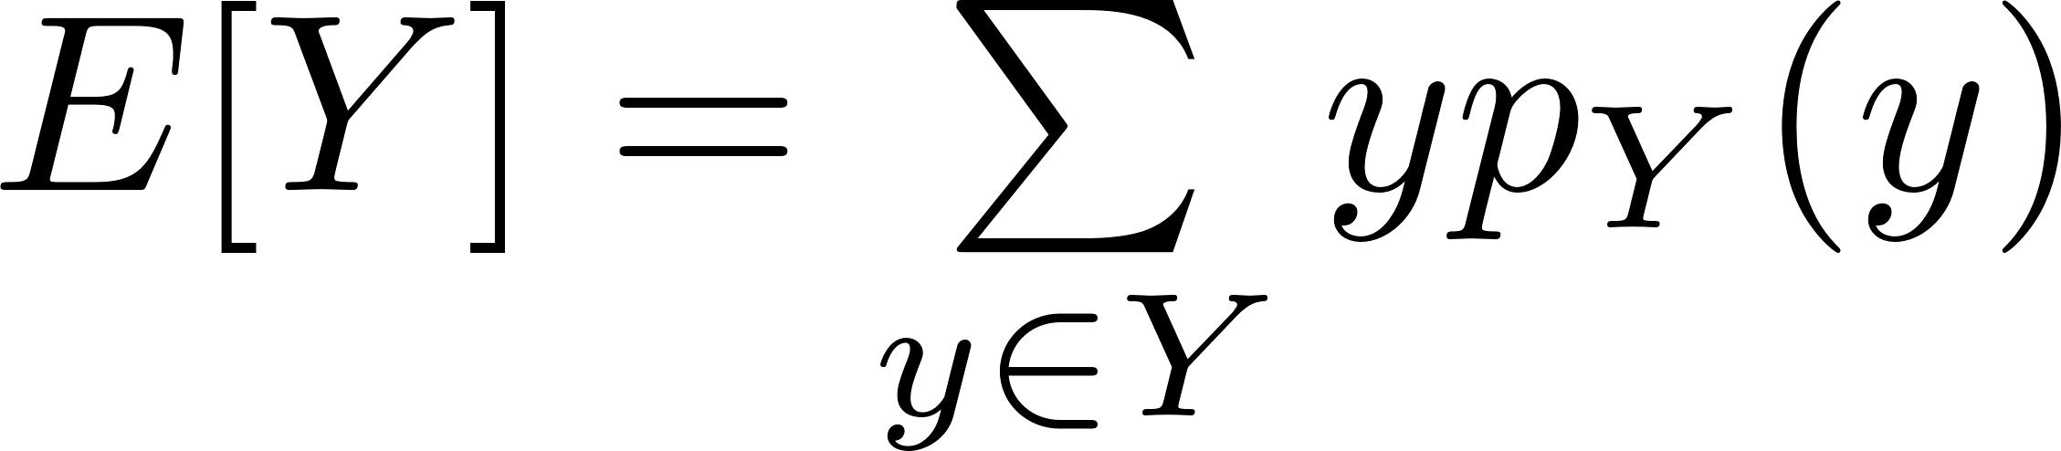
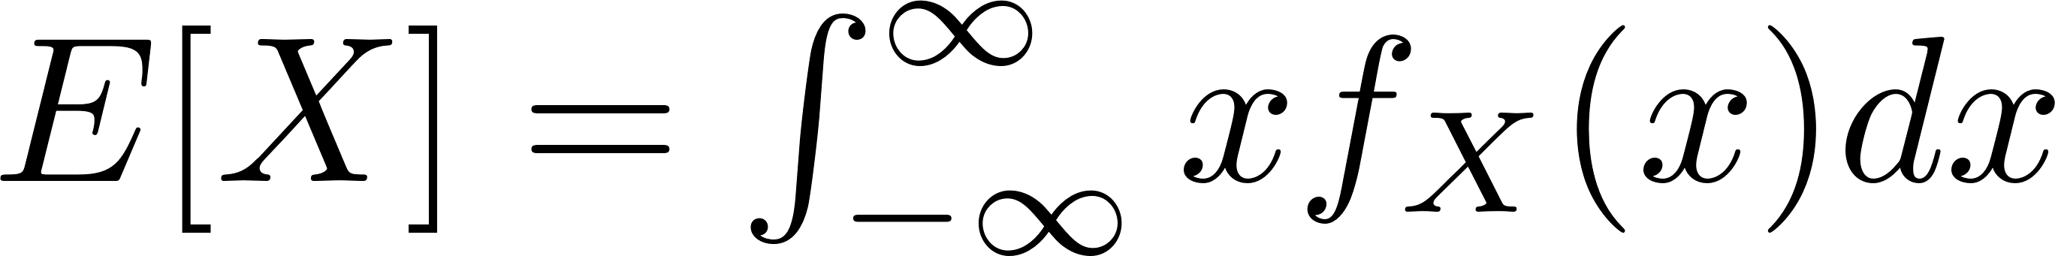

Expectation and Variance of Continuous Random Variables
Discrete
Continuous
CS 355/555 Probability and Statistics for CS
28/42 13:34

Slide 31
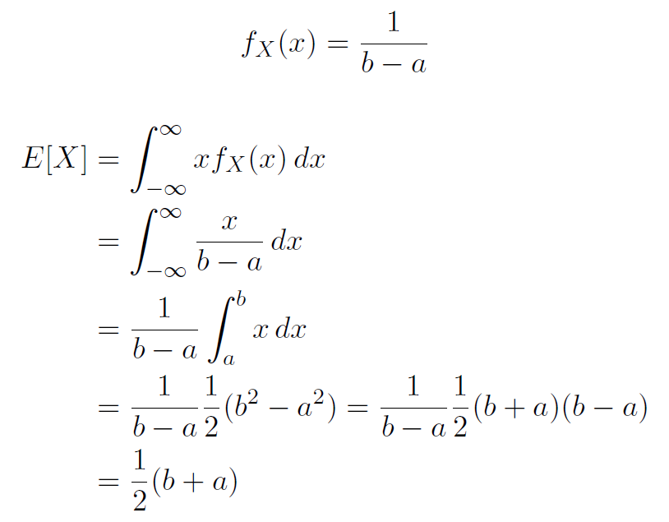

Expectation and Variance of Continuous Random Variables
CS 355/555 Probability and Statistics for CS
29/42 13:34

Slide 32
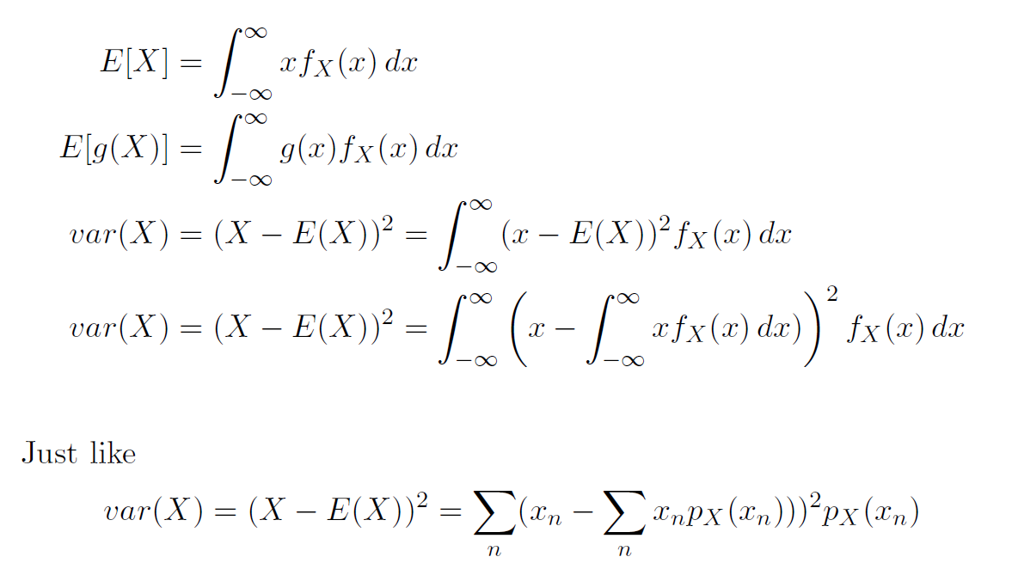
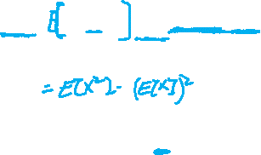
Expectation and Variance of Continuous Random Variables
CS 355/555 Probability and Statistics for CS

Slide 33
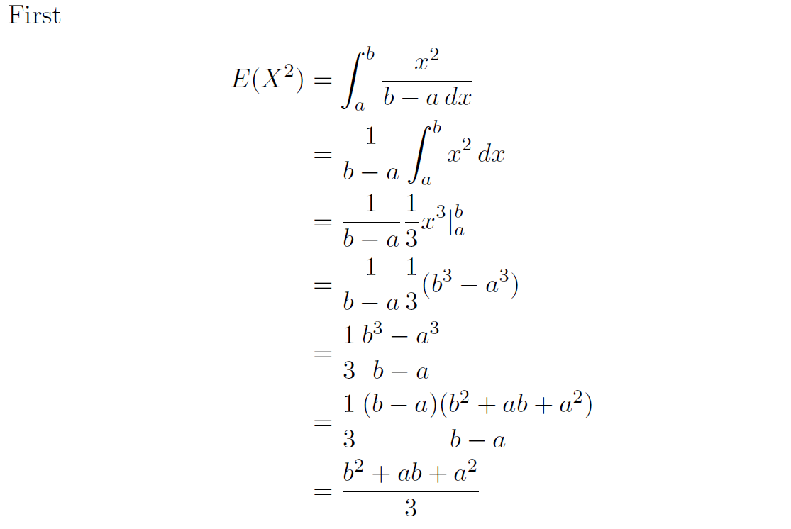
Example 3.4: Variance - Uniform Random Variable
32/42 13:34

Slide 34
Example 3.4 - Variance of Uniform Random Variables
Then
var(X) = E[X²] − (E[X])²
a² + ab + b² (a + b)²
=
−
3
4
3(a + b)²
4(a² + ab + b²)
=
−
12 12
4a² + 4ab + 4b² − 3a² − 6ab − 3b²
=
12
a² − 2ab + b²
=
12
2
(a − b)
=
12
(length(a, b))²
=
12
CS 355/555 Probability and Statistics for CS
33/42 13:34

Slide 35
Example 3.4 - Variance of Uniform Random Variables
Then
(length(a, b))²
var(X) =
12
Just like in the discrete case, values of a and b don’t matter, just length of the interval.
CS 355/555 Probability and Statistics for CS

Slide 36


Exponential Continuous Random Variable]- pg 146
Exponential Random Variables very important modeling independent arrival times.
Customer arrival at a bank Web site hits
Light bulb burnout Component failure Many more
CS 355/555 Probability and Statistics for CS

Slide 37



Exponential Random Variable- pg 146
CS 355/555 Probability and Statistics for CS
37/42 13:34

Slide 38
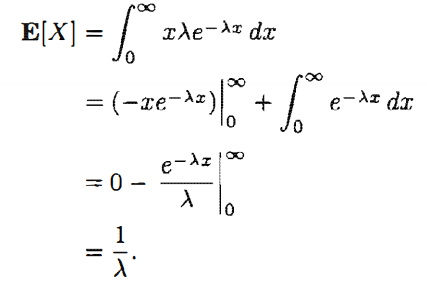
Exponential Random Variable- pg 146
37/42 13:34

Slide 39
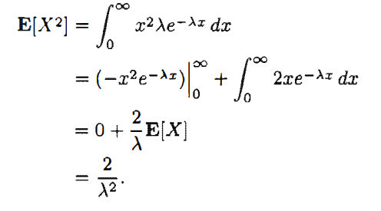


Exponential Random Variable- pg 146
37/42 13:34

Slide 40
Quiz:
An electronics company manufactures a type of component that is critical for aerospace applications. The time until failure of this component follows an exponential distribution with a mean life expectancy of 10,000 hours.
What is the probability that a component fails within the first 5,000 hours of operation?
What is the probability that a component lasts longer than 15,000 hours of operation?

Slide 41
Next Time
Read
Read 3.2, pg 148 - Cumulative Distribution Functions
CS 355/555 Probability and Statistics for CS
42/42 13:34

